Slide 1
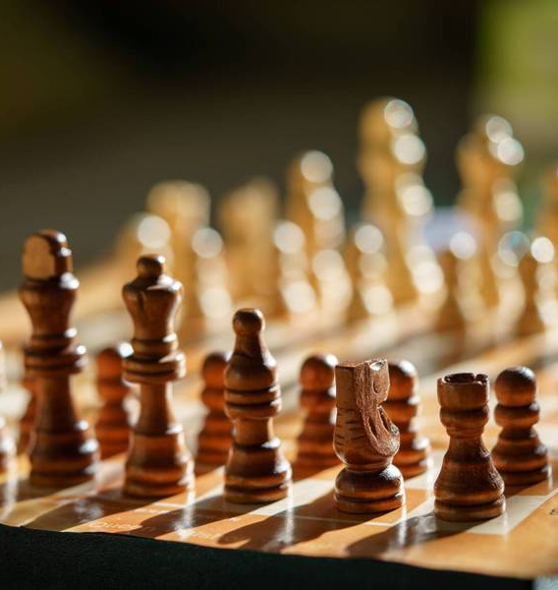
Chess Engines on GPU’s
Jonathan Jehoshaphat
2036334
MSc Advanced Computer Science

Slide 2


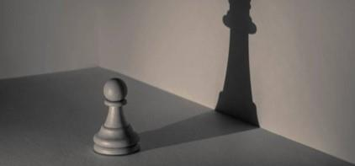
Agenda
Overview
GPU’s and Chess Engines
Chess Algorithms
Recent ML breakthroughs
Conclusion

Slide 3

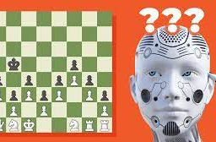
Overview

Slide 4
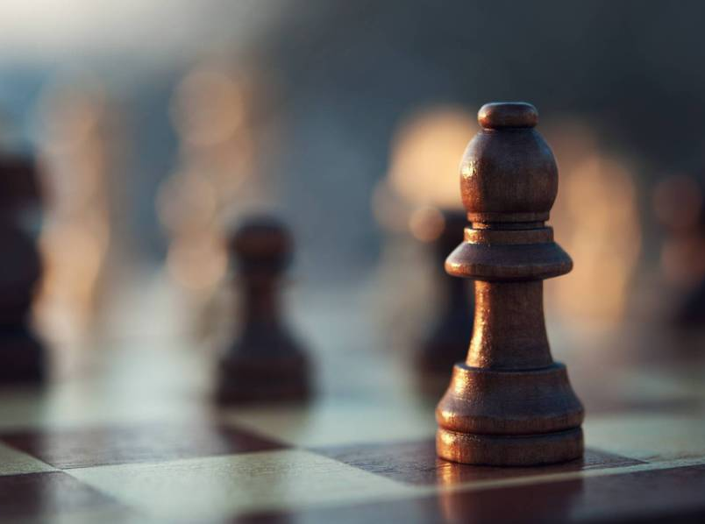
Overview
Chess as a game is played with strong strategic moves. The advancement in technology has improved to a major extent to which a Computer is able to define the moves made by the opponent and is able to get a calculative response so fast and accurate that is unimaginable.
The approaches in which enable GPU’s to play chess and the algorithms which are designed through every step of the way is a very technical way to observe and grasp how exactly the engines gain from the algorithm and process the futuristic outcome.

Slide 5
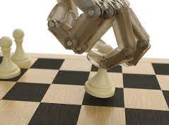
Overview
In 1997 Deep blue became the first Chess playing expert system to beat Garry Kasparov who was a Chess champion in that time period. The system was developed in a way in which it valuated all the parameters of the previous games which was given as the input. It had a capability of calculating up to 200 million chess moves per second.
In the first game the 44th move made by Deep Blue was unknown to Garry which led to him losing the match. Deep Blue had custom built Very Large Scale Integration Chips to use the technique of parallel computing to parallelize the alpha-beta search algorithm. In other words, Deep Blue had claimed superior intellectual in Chess. This is very amazing to see because a computer is able to think, calculate and execute as similar to a human being.

Slide 6
Chess Engines & GPU’s

Slide 7
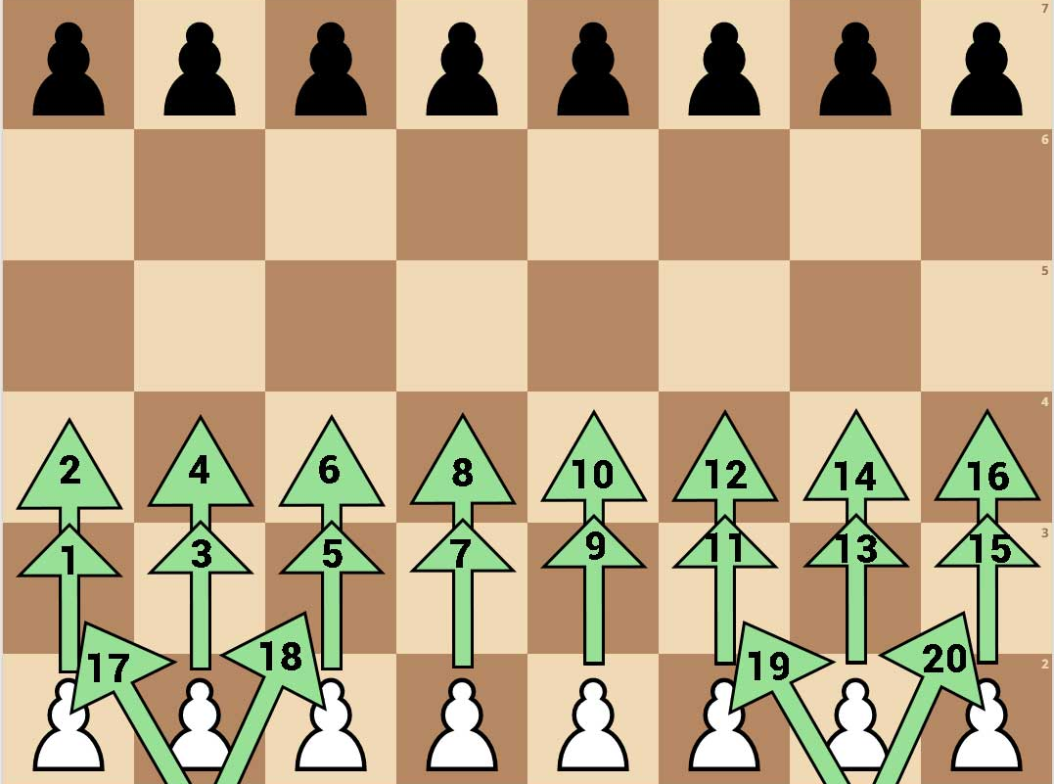
Chess Engines & GPU’s
GPU’s were initially designed to digitally process a image through specific algorithms. Even though it is proven that GPU’s have more raw computing power than a CPU, GPU’s need a specialized and parallelized way of programming. However a set of algorithms which use the concept of machine learning which is deep learning was the only methodology which worked very well with the GPU architecture.
There are basically three approaches on how to use a GPU for chess which are as follows: Firstly, it can be used as an accelerator in Leela Chess Zero(LC0) which uses a concept of deep neural network which not similar to the usual chess programs which use the concept of linear function approximation.
Secondly, Offload the search in Zeta. Zeta is a opensource chess engine which is written in C and uses ports which link up to the alpha beta search algorithm. Zeta uses ports and has 64 GPU threads which are coupled to one which helps in move generation, move picking and evaluation. Lastly, as an hybrid in perft_gpu, which is basically a brute force program which counts the leaf nodes and explores a tree (Ankan,2017).

Slide 8
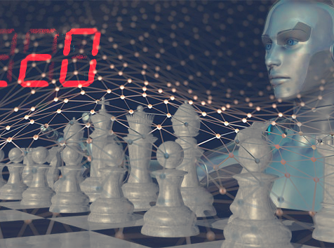
Chess Engines & GPU’s
Since there are many Chess engines, the classification of these engines take place on two factors which are Speed in which it calculates the opponents moves and the iteration of the tree and the other factor is Accuracy in which it evaluates the chess board. Stockfish is a Chess engine which uses bitboards to form similarity to a chess board and further uses logical operations based on a single move made by the opponent. The tree is built after it gets the evaluation of all the possible moves at that particular time. This is an example of a stockfish code which is to get a square attacked by a bitboard of pawns.
Template Constexpr
Bitboard pawn_attacks bb(bitboard b)
{ Return C == White ? shift(b) | shift(b) : shift(b) | shift(b); } (Antoine Champion,2021)

Slide 9
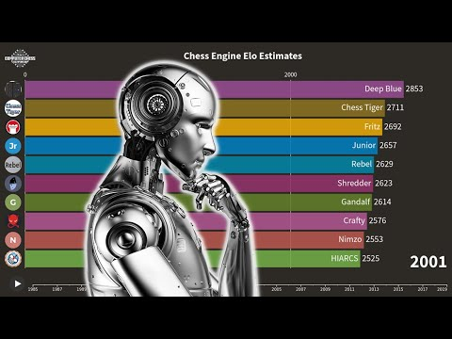
Chess Engines & GPU’s
Here, Stockfish is creating a blockers board which is the result of the logical operation of Complete board at that moment of time AND the attack mask. Stockfish creates blockers board to hold the index of array of the opponents precalculated moves. Hash key is used to reduce the amount of memory stored in the original bitboards. The sliding pieces are the ones which have an indefinite movement in a particular direction till the edge of the board unless obstructed by any other piece.
AlphaZero however is a highly advanced chess engine which was developed by Deepmind, acquired by Google. This engine was just taught the rules of the game and it ended up playing 44 million times by itself. It has the power to calculate upto 70 million moves per second. This engine is not open to the public.
It runs on custom built hardware usually known as Google Supercomputer and can easily beat Stockfish. On the other hand, AlphaGo works on MCTS(Monte Carlo Tree Search) Algorithm. It builds upon four different steps which are Selection, Expansion, Evaluation and Backup.

Slide 10
Chess Algorithms

Slide 11
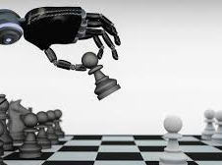
Chess Algorithms
The Minimax algorithm is a recursive algorithm in which we assume that both the white and black players have the best moves, however the greater priority is given to maximizing white’s score. This algorithm gives one player a certain chance of winning. The depth-first search takes place after which the leaf nodes are evaluated. All the moves which are calculated by the maximizing player are denoted as positive affinity and all the moves made by the minimizing player are denoted as negative affinity.
The minimax function return a heuristic value of the leaf nodes and favours the score of the maximizing player. Based on this observation, max(a,b) will be equal to -min(-a,-b). The code treats both maximizing and minimizing player separately. Minimax can be simplified into a negamax algorithm.

Slide 12
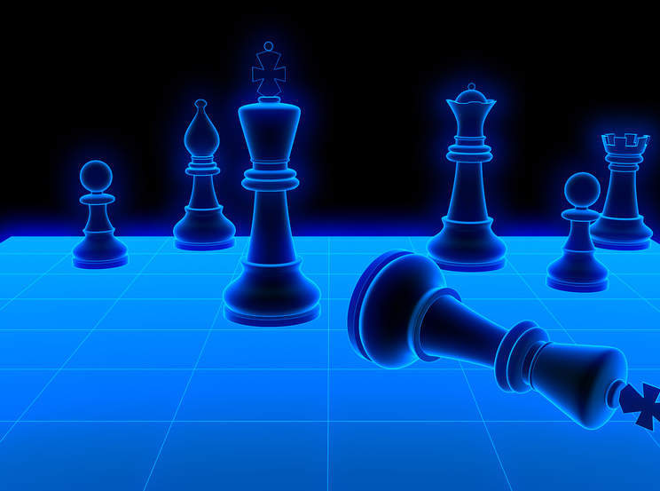
Chess Algorithms
Negamax Algorithms use similar trees such as game trees as used in Minimax algorithms. But here the root node will take the score from its next immediate child node. The child node which depicts the high score from the root node gives the best possible move to play. The maximum value is always searched by the negamax algorithm and that is why for player B it would always be the minimax score is always the negation of the negamax score obtained.
Alpha-beta pruning always decreases the number of nodes which the negamax algorithm evaluates in its specific search tree. Basically Alpha-Beta are the upper and lower bounds for the child node. When the pruning portion takes place, the values which are falling outside the alpha-beta bounds are eliminated, whereas the values which fall in between are given the true value. These values do not affect the root node at all. The complication here starts when the transposition table is added because it becomes difficult to track a node’s value because the value may not be the node’s true value

Slide 13
Recent ML breakthroughs in Chess

Slide 14
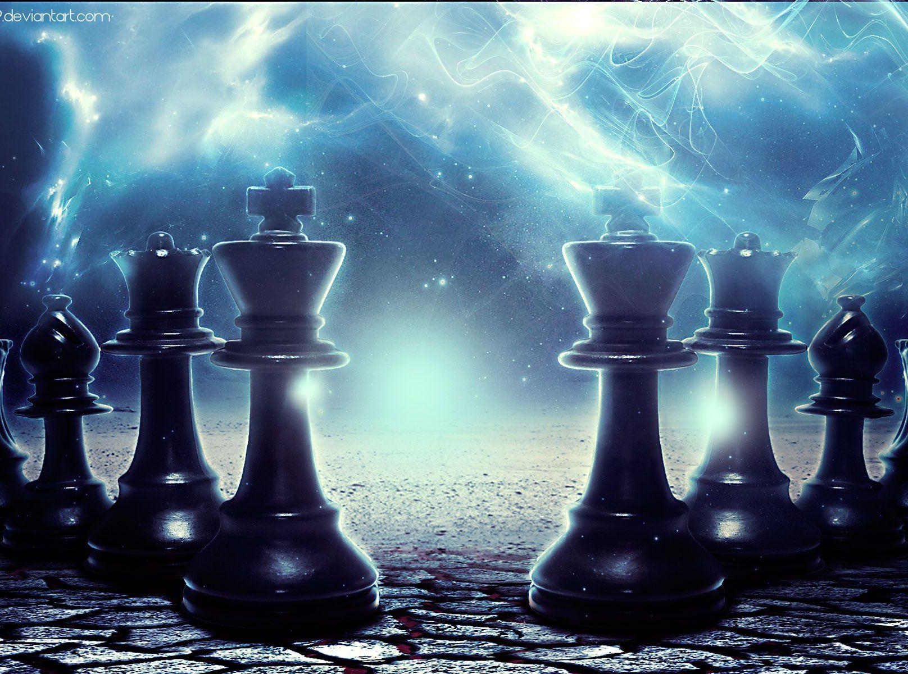
Recent ML breakthroughs in Chess
Matthew Lai from Imperial College of London has recently created a Artificial Intelligence based system called as Giraffe. It has taught itself to play chess much more like a human being by evaluating positions and in a very different way as compared to the conventional chess engines. The concept behind this is of a neural network, tends to work as close to similar as the human brain.
It consists of layers of nodes which are connected to each other in a way in which it automatically trains itself and self-tunes the best possible move. It is equivalent to that of a FIDE International Masters status which is in turn equivalent to 2.2 of the top chess players in the world.

Slide 15
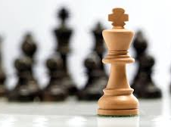
Recent ML breakthroughs in Chess
Maia was developed from the roots of the code of Leela Chess Zero which favours accurate human calculations.
Maia works very differently as compared to the usual chess engines, here it favours the highest possibility of the human move. The data to teach Maia was fetched from LiChess which is an online chess program. Now Maia is tuned to different levels of gameplay.

Slide 16

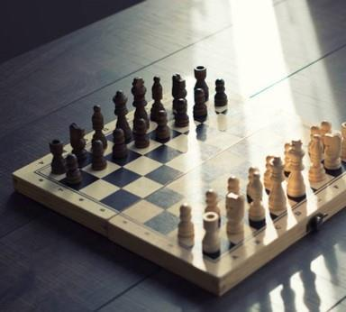
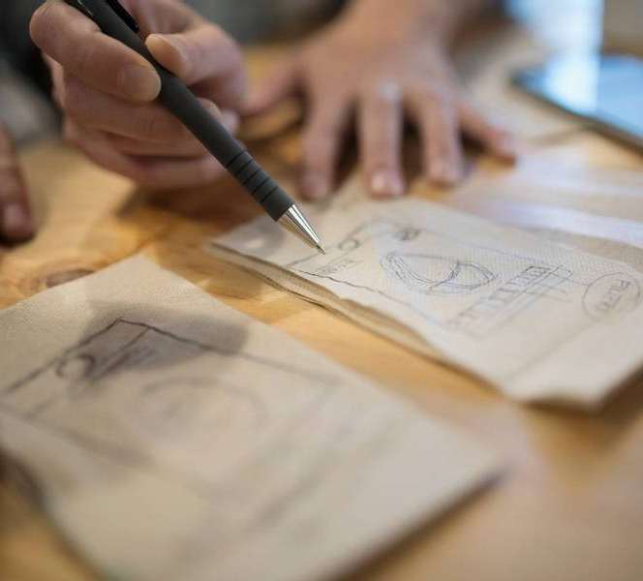
Conclusion
The advancements in technology is growing so vast in the present day that a non-living object(computer) is turned to a living one which not only matches the strategy of human gameplay but also is capable of outsmarting and defeating the human players.
These Chess engines not only define the power of self calculation and understanding but also bring out the true meaning of Developing further and ahead. The algorithmic design enables the fine tuning of calculation which is made in seconds but is able to give the most accurate move possible. ​

Slide 17
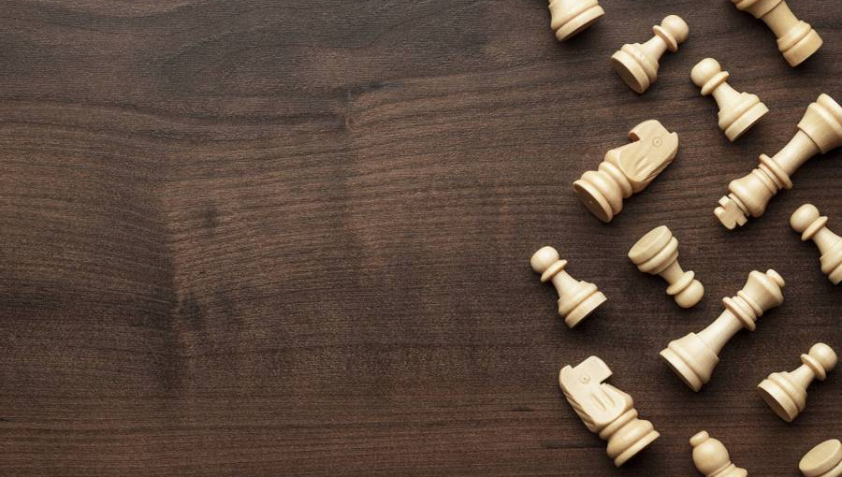
“When you see a good move, look for a better one.” –
Emanuel Lasker

Slide 18
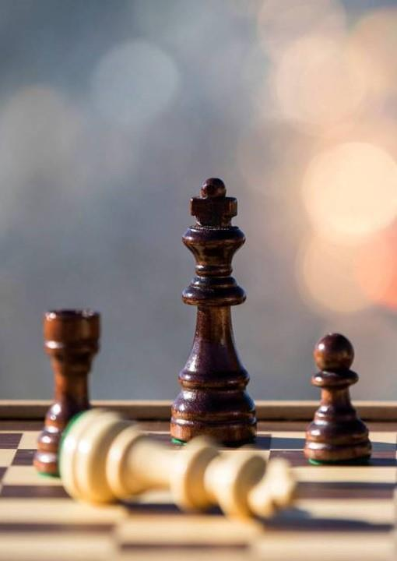
Thank You
Jonathan Jehoshaphat
2036334
MSc Advanced Computer Science
CSCM10

